Slide 1


Only Celebs
“Giving Power to the Celebrities”
Caden R

Slide 2

Introduction – The Engineers
Caden R – I'm currently enrolled in a Data Science bootcamp
Caden G – I want to work on AI to help Humanity, not replace them.
Cole – I've been able to work on a Nuclear Reactor
Tyler – I’m currently working on bioinformatics undergraduate research
Tyler

Slide 3

Overview
We want to show who's the most popular. To do this, we wanted to make a site where the most popular people can post and be given power.
We will give abilities depending on who is more popular than the others. Through a leaderboard system.
This leaderboard system will be based on views, likes, and dislikes.
We will prioritize the celebrities' experience, which includes their ability to interact with each other and their fans.
Caden

Slide 4

Overview
The way we will distinguish between a normal user and a celebrity will be shown as something similar to Twitter's checkmark.
This checkmark will prove the celebrity's legitimacy.
This will take care of problems like fake accounts.
We want Only Celebs to be a secure place for celebrities, so they can become more popular and powerful.
Caden

Slide 5

In Scope
The app will work on mobile phones and desktop
Timeline / Feed
Posting videos and messages
Like / Share Functions
Cole

Slide 6

Out of Scope
In App Store or Marketplace
Will not outsource or import data form other applications/organizations
Won't be able to do advanced live streaming
The software will not work without a stable connection
Cole

Slide 7
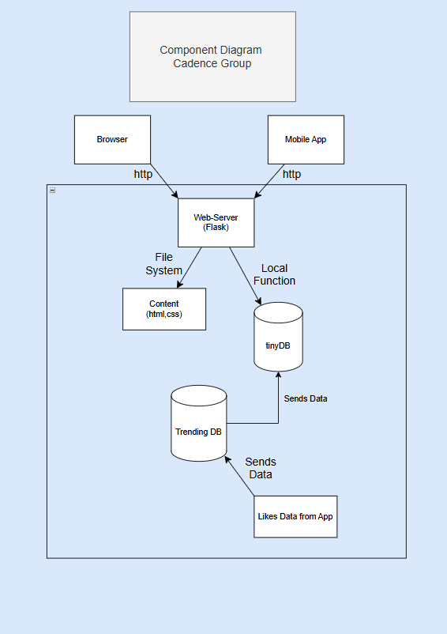
Architecture
No 3rd party dependencies
Users will interact through the browser which communicates with flask to act as the web server.
Files such as videos and photos will be stored in the file system
Databases:
Trending -> stores trending topics and posts
Tinny -> keeps track of all local posts
Tyler

Slide 8
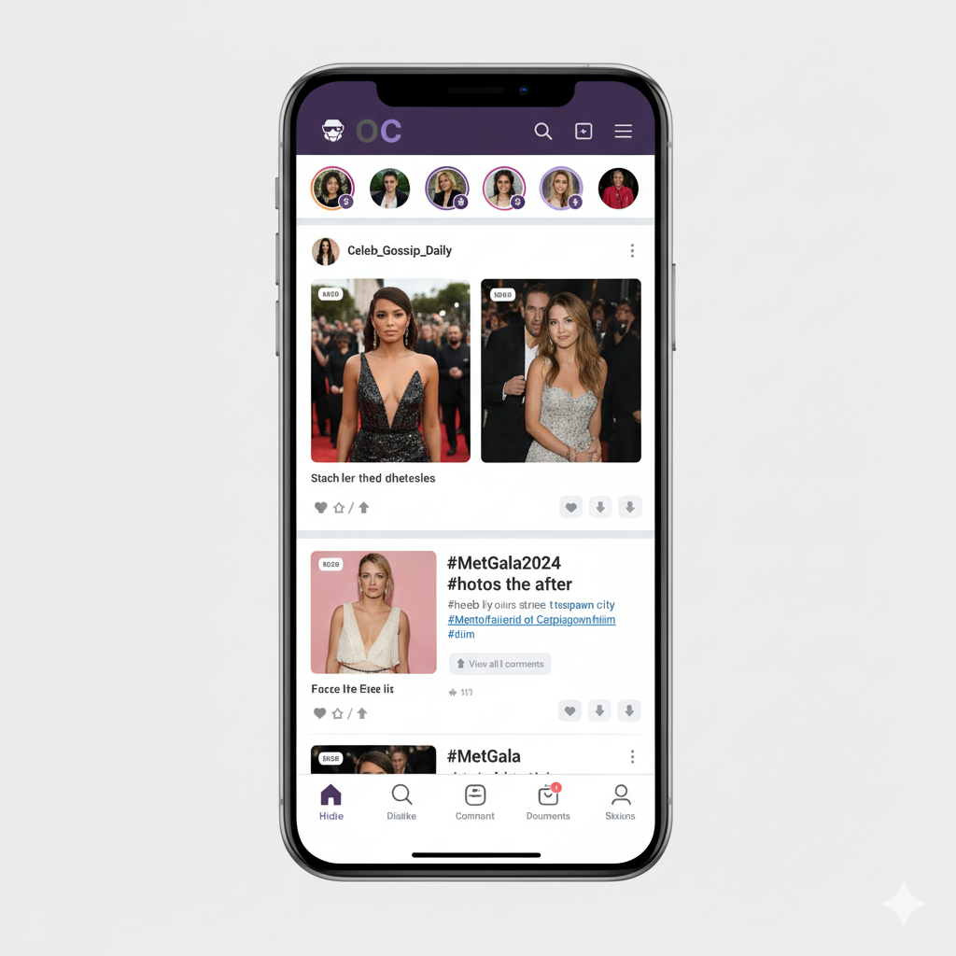
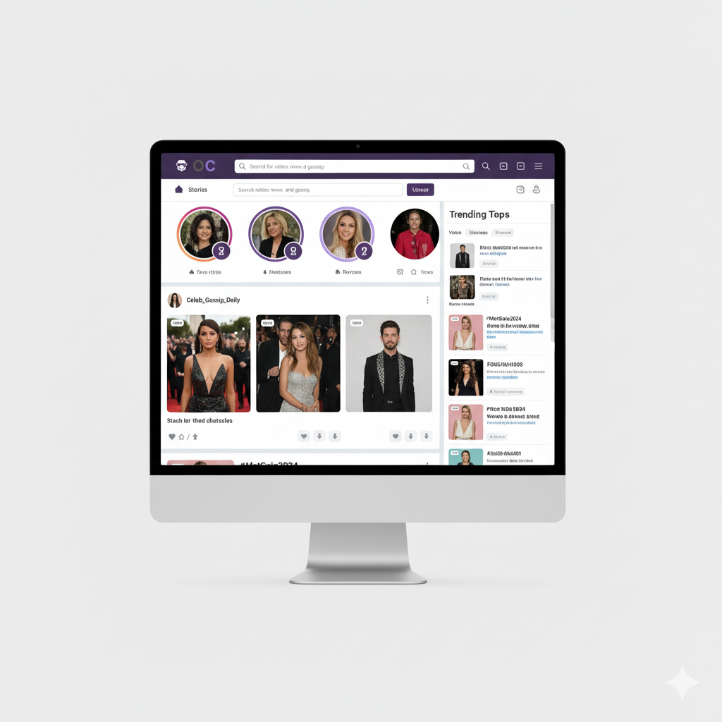
UI Mock Up
Caden R

Slide 9
Summary
Only Celebs is, in fact, a PERFECT solution to the vast issue of understanding who is actually the most popular. By giving a platform for the most famous of people to be recognized. That way, we can acknowledge people for what really matters... their popularity.
ONLY THE POPULAR SURVIVE
Caden

Slide 10

Q & A Any Comments/Questions?
Tyler

